Slide 1

Unit 6

Slide 2


1. To be able to get information from the reading material about different kinds of resolutions
2. To learn the new words and useful expressions

Slide 3


Talk about your new year’s resolutions and how you are going to make them work.

Slide 4



1. able adj. 能够
be able to 能够做某事
e.g. They are able to speak English well.

Slide 5

2. promise n. 承诺; 诺言
e.g. Don’t make promises you can’t keep.
不要许下不能兑现的诺言。
promise v. 许诺; 承诺
e.g. Hurry up – we promised we wouldn’t be late.
快点，我们保证过不会迟到的。

Slide 6
3. beginning n. 开头; 开端
at the beginning of 在……开始
e.g. They sang a song at the beginning of the meeting．
会议开始时他们唱了一首歌。
4. improve v. 改进; 改善
e.g. He studied harder to improve his English.
他更加努力提高英语水平。

Slide 7

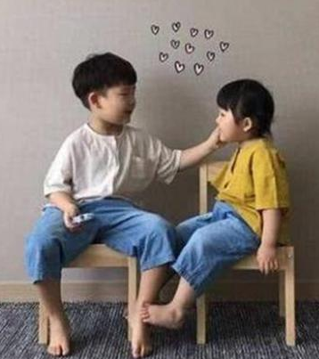
5. write down 写下; 记录下
e.g. Write down the address before you forget it.
把地址写下来, 省得忘了。
6. themselves pron. 他(她、它)们自己
e.g. The children can look after themselves for a couple of hours.
孩子们能照顾自己几个小时。

Slide 8
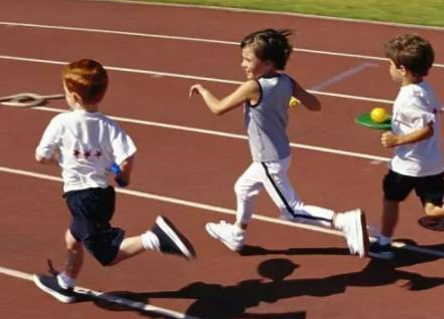
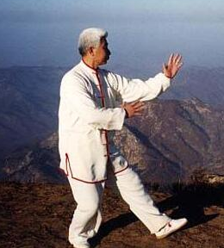
7. physical adj. 身体的
e.g. Physical activities are good for health.
体育活动对健康有益。
8. hobby n. 业余爱好
复数形式: hobbies
e.g. My grandpa’s hobby is
practicing Tai Chi.
我爷爷的爱好是打太极拳。

Slide 9

9. have to do with 与……相关; 与……有关联或有关系
e.g. What does this have to do with me?
这和我有什么关系？
10. take up (尤指为消遣) 学着做; 开始做
e.g. I think I’ll take up oil painting in my spare time.
我想我将要在业余时间学习油画。

Slide 10

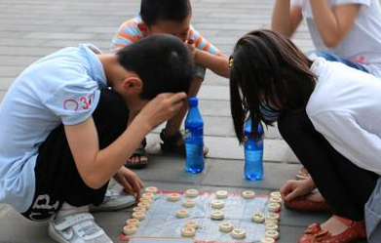

11. paint v. 用颜料画; 在……上刷油漆
e.g. We painted the door blue.
我们把门漆成了蓝色。
12. weekly adj. & adv. 每周的(地)
e.g. We play Chinese chess twice weekly.
我们每周下两次中国象棋。
13. schoolwork n. 学校作业; 功课
e.g. He is trying to keep up with his schoolwork.
他在努力完成作业。

Slide 11
14. meaning n. 意义; 意思
e.g. The expression has two very different meanings in English.
这个表达在英语中有两个完全不同的含义。
15. question v. 表示疑问; 怀疑; 提问; 质询
e.g. I’d like to question you on your views about the housing problem.
我想问问你对住房问题的看法。
question n. 问题

Slide 12
16. discuss v. 讨论; 商量
e.g. We discussed when to go/when we should go.
我们商量了什么时候动身。
discussion n. 讨论

Slide 13

Last year’s resolutions | Kept or not | Why

Slide 14
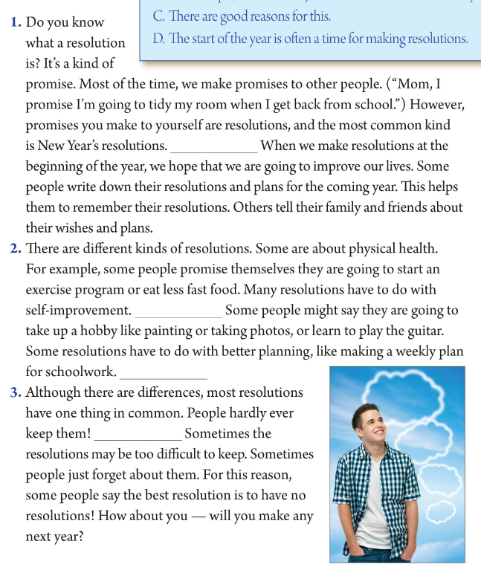
3
Underline the words
and phrases
that helped
you decide.
__ To question the idea of making resolutions
__ To give the meaning of resolution
__ To discuss the different kinds of resolutions
1
2

Slide 15

Unit 6
I’m going to study computer science.

Slide 16



Slide 17


Free Talk
Discuss the questions with your partner.(discuss sth with sb)
1. Did you make any resolutions last year?
2. Were you able to keep them?
Why or why not?
Let’s read an article about resolution!

Slide 18


Slide 19


Read the passage fast, underline the key words/phrases and match each paragraph [1—3] with its main purpose(目的).
__ To question the idea of making resolutions
3
__ To give the meaning of resolution
1
__ To discuss the different kinds of resolutions
2

Slide 20
3
Underline the words
and phrases
that helped
you decide.
__ To question the idea of making resolutions
__ To give the meaning of resolution
__ To discuss the different kinds of resolutions
1
2

Slide 21
Read the passage carefully.
Put the sentences [A—D] in the correct places in 2b and answer the questions in 2d.
These are about making yourself a better person.
For example, a student may have to find more time to study.
C. There are good reasons for this.
D. The start of the year is often a time for making resolutions.

Slide 22
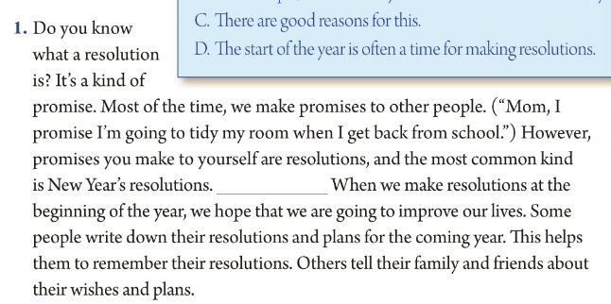
Para1 To give the meaning of resolution
D
A. These are about making yourself a better person.
B. For example, a student may have to find more time to study.
C. There are good reasons for this.
D. The start of the year is often a time for making resolutions.

Slide 23

Para1 To give the meaning of resolution
Read paragraph 1 and answer the questions.
What is a resolution?
2. When do people usually make resolutions?
It’s a kind of promise you make to yourself.
(It’s a kind of promise. Promises you make to yourself are resolutions.)
People usually make resolutions at the beginning/start of the year.
3. Why do people usually make resolutions?
Because they hope that they are going to improve their lives.
4. How can people remember their resolutions?
Some people write down their resolutions and plans.
Others tell their family and friends about their wishes and plans.

Slide 24

Let’s listen and read.
Para1 To give the meaning of resolution
The start of the year is often
a time for making resolutions.

Slide 25
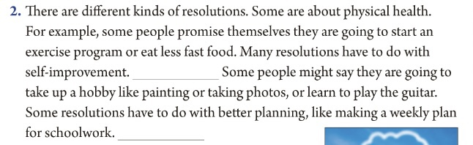
Para 2 To discuss the different kinds of resolutions
A
B
A. These are about making yourself a better person.
B. For example, a student may have to find more time to study.
C. There are good reasons for this.
D. The start of the year is often a time for making resolutions.

Slide 26
Para2 To discuss the different kinds of resolutions.
Read paragraph 2 and answer the question.
5. How many kinds of resolutions does the writer talk about?
What are they?
The writer talks about three different kinds of resolutions.
They are physical health, self-improvement and better planning.

Slide 27
Let’s listen and read.
Para2 To discuss the different kinds of resolutions
These are about making
yourself a better person.
For example, a student may
have to find more time to study.

Slide 28
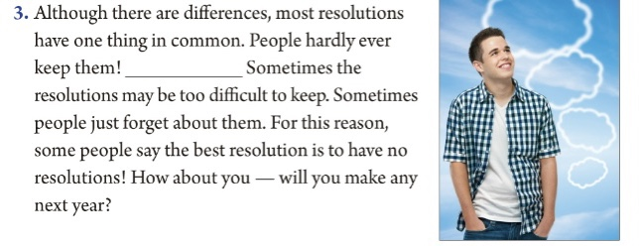
Para3 To question the idea of making resolutions
C
A. These are about making yourself a better person.
B. For example, a student may have to find more time to study.
C. There are good reasons for this.
D. The start of the year is often a time for making resolutions.

Slide 29
Para3 To question the idea of making resolutions
Read paragraph 3 and answer the questions.
6. Why do you think resolutions may be difficult to keep?
7. Do you think the best resolution is to have no resolutions? Why or why not?
Because sometimes they may be too difficult to keep
or sometimes people just forget about them.
Yes,because I made my New Year’s resolutions last year but I didn’t keep them.
No, because resolutions can help us try our best to keep them.

Slide 30
Let’s listen and read.
Para3 To question the idea of making resolutions
There are good
reasons for this.

Slide 31
2e Write your own sentences with them.
have to do with
例：他的问题都是与音乐有关。
His questions have to do with music.
make promises
例：在年初，我们经常向自己许下诺言。
At the beginning/start of the year, we often make promises to ourselves.
have...in common
例：所有达人秀都有一个相同的特征。
All the talent shows have one thing in common.

Slide 32
2e Write your own sentences with them.
write down
例：请写下这些新单词。
Please write down these new words.
for this reason
例：我7：45起床，因此，我早上迟到了。
I got up at 7:45. For this reason, I was late this morning.
take up
例：今年，我将开始学习钢琴。
This year, I’m going to take up learning the piano.

Slide 34
A. These are about making yourself a better person.
B. For example, a student may have to find more time to study.
C. There are good reasons for this.
D. The start of the year is often a time for making resolutions.
D
A
B
C

Slide 35
阅读策略
1. D The start of the year is often a time for making resolutions.
D 句意：新年伊始常是许下新年决心的时候。
第一段中介绍了resolution的意思。第一空格前句意“最普通的一种就是新年决心”，空格后句意为“当我们在新年的开端许下新年决心的时候……”可推测出本空应填此句。

Slide 36
2. A These are about making yourself a better person.
A句意：这些决心是有关让你自己成为一名更优秀的人的。
由前一句话“很多决心与自我提高有关。”，可知空格处是对这句的进一步解释。

Slide 37
B For example, a student may have to find more time to study.
B句意：例如, 一名学生可能必须利用更多的时间来学习。
本段中介绍了不同类型的决心，并一一举例说明。由空格前所列第三种 “与更好的计划有关的决心”，本空格处应为举例说明这种类型的决心的情况。

Slide 38
3. C There are good reasons for this.
C句意: 对此种情况有不错的理由。
本段中心意思是对许下新年决心这种想法的怀疑。由空格前句意“人们很难实现他们”，及空格后的两句都是叙述不能实现这些决心的原因, 可知空格处应选C句。

Slide 39
第一段：It’s a kind of promise. However, promises you make to yourself are resolutions, …
第二段：There are different kinds of resolutions. Some…; Some resolutions…
第三段：People hardly ever keep them! … the best resolution is to have no resolutions!

Slide 40
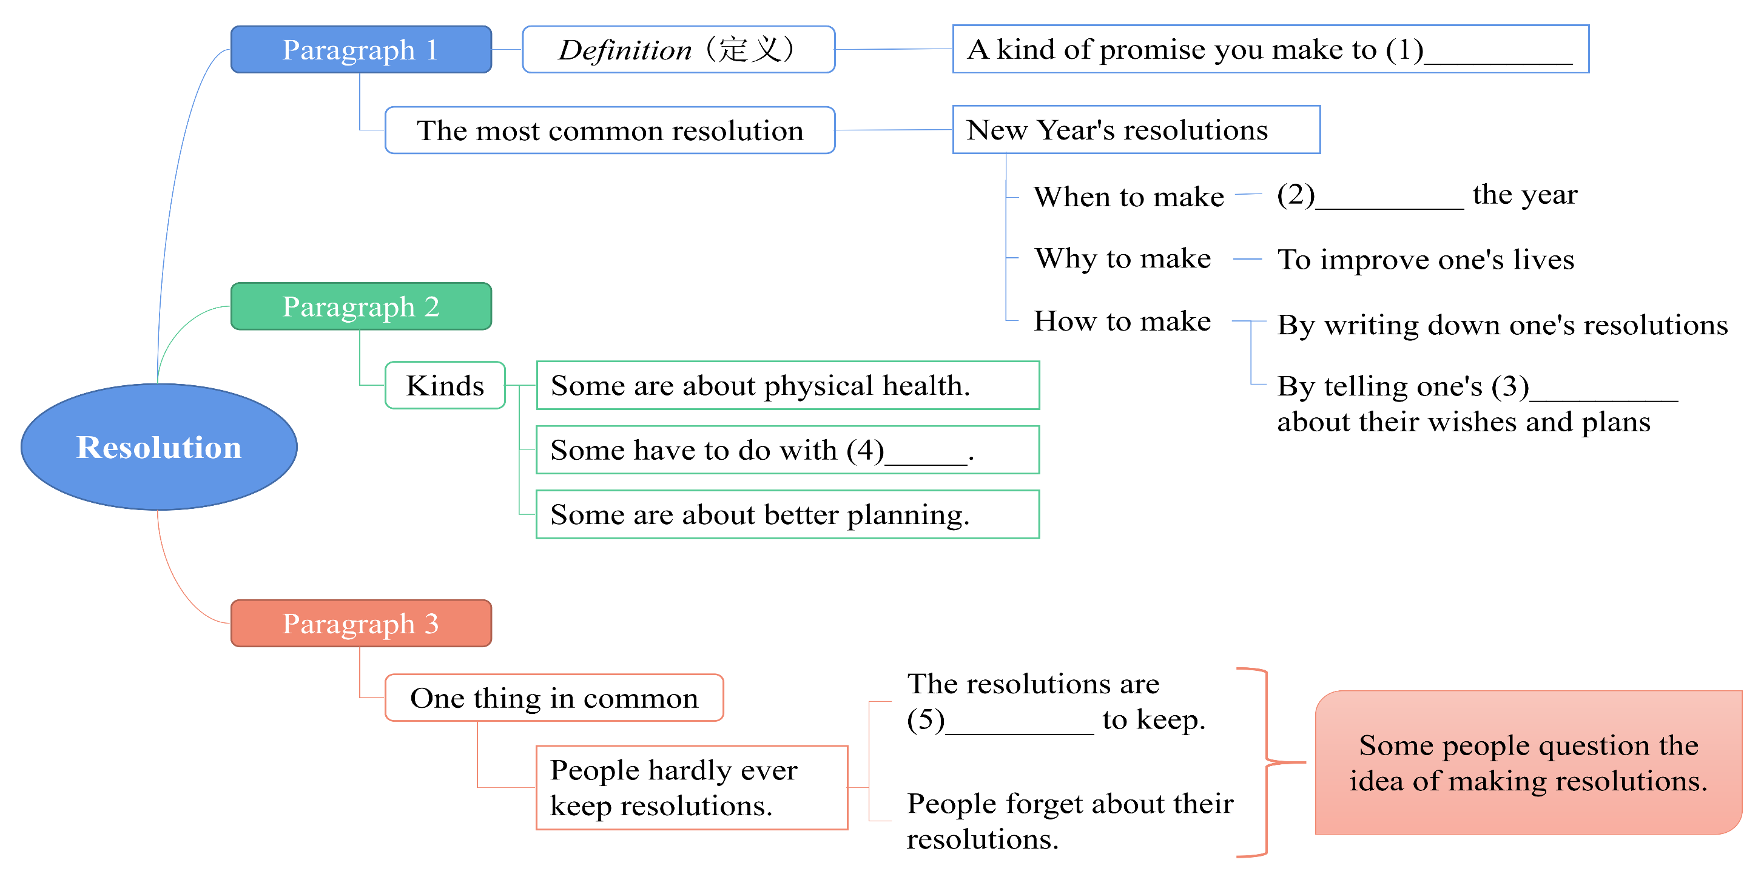
Read the passage again and fill in the blanks.

Slide 41
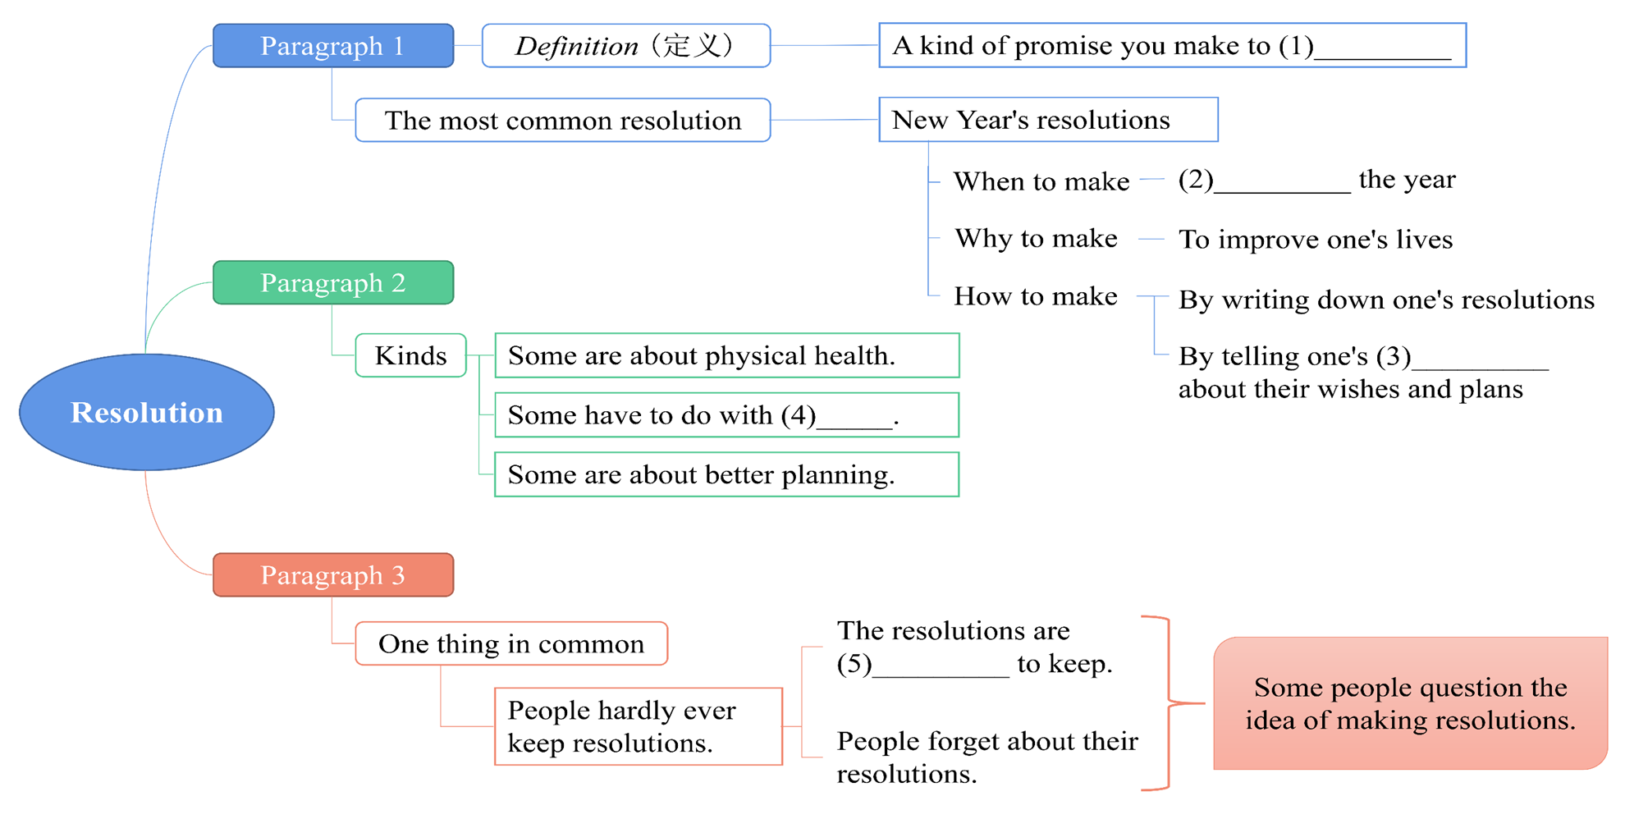
yourself
At the beginning of
family and friends
self-improvement
too difficult

Slide 42

Finish the summary of the text and then try to retell it.
promises
Resolutions are different kinds of ____________________, and the most common kind is ____________________. When we make resolutions _________________ the year, we hope that we ____________________ improve our lives.
New Year’s resolutions
at the beginning of
are going to

Slide 43
There are different kinds of resolutions. Some are about ________________________ health. Some have to do with ________________________. Some are about better planning, like ________________________ for school work. Although there are differences, most resolutions ________________________. People hardly ever keep them! For this reason , some people say the best resolution is to ________________________!
physical
self-improvement
making a weekly plan
have one thing in common
have no resolutions

Slide 44


在……开始
能够做某事
由于这个原因
合理的规划
关于；与……有关系
下决心
不同种类的
向某人许下诺言
at the beginning of
be able to do sth.
for this reason
better planning
have to do with
make resolutions
different kinds of
make promises to sb.

Slide 45
一年的开始
身体健康
改善我们的生活
(尤指为消遣)学着做; 开始做写下；记录下
有相同特征；(想法、兴趣等方面)相同
太……而不能……
the start of the year
physical health
improve our lives
take up
write down
have ... in common
too ... to ...

Slide 46


根据句意及所给首字母提示，补全句中所缺单词。
First, find a(n) h , like playing chess, then you
can make some new friends with similar interests.
2. I q him about what he did last night, but he
said nothing.
3. The word “flight” has two different m : a
journey (行程) by air, and the act of running away.
4. We got together to d our plans for the future.
5. I think the best way to i my English is to study
English in England.
hobby
questioned
meanings
discuss
improve

Slide 47
II.根据句意及所给汉语提示，写出所缺内容，每空一词。
1. It’s raining hard outside. _______ _______ _______(由于
这个原因), Lisa has to stay at home.
2. Ken _______ _______(开始) painting last year, but soon
lost interest.
3. I’m not sure what he does for a living but I know it
_______ _______ _______ _______(关于) computers.
For this reason
took up
has to do with

Slide 48
4. We will go to the countryside _______ _______ _______
_______ _______(在六月初).
5. Did you _______ _______ _______(许下诺言) to your
mother?
at the beginning
of June
make a promise

Slide 49
Ⅲ. 根据汉语意思，完成英语句子，每空一词(含缩略形式)。 1. 让我们先制订一个周计划，然后开始实施。
Let’s _______ _______ _______ _______ first and then
carry it out.
2. 我弟弟还不会走路。
My brother _______ _______ _______ walk yet.
3. 这个问题太难了，我回答不了。
The question is _______ difficult for me _______ answer.
make a weekly plan
isn’t able to
too to

Slide 50
4. 在你的笔记本上把一些重要的点记下来是很有必
要的。
It’s necessary _______ _______ _______ some important points in your notebook.
5. Bill喜欢踢足球，他想成为足球队的一员。
Bill likes playing soccer and he would like to _______
_______ _______ _______.
to write down
make
the soccer team

Slide 51


1. Review the passage.
2. Find these phrases in the passage. Then write your own sentences with them.
have to do with; make promises
have… in common; write down
for this reason; take up

Slide 52


